Slide 1

Voice Activity Detection Itai Shimonov & Matan Lerner

Slide 2
Our Goal – in a nutshell
We aim to recognize the human speech and to differ it from the rest of the audio, we want to know the parts of the audio that contain human speech.

Slide 3

How do we implement the idea?

Slide 4
First steps: calculation!
1. As we take the audio signal as an input, we first calculate the energy of the signal in all samples of the signal.
2. Then, we calculate the “Voice Activity threshold” – the minimal value of a signal energy which can be considered as “Voice”
We then use those calculation for our next steps:

Slide 5
Detection of Voice Activity
We use the calculated threshold from earlier, and we create a binary array of speech detection – we go over the energy samples and for each frame we compare it to the VAD Threshold and insert a one in the array slot if the sample energy bypasses the threshold, and zero, otherwise.
We smoothen the binary array by comparing gaps that contain zeroes in the array to the human speech frequency, to solve a problem that we faced.
In the end, we get a binary array with the same length of the input signal, that contains in which time frames human speech was detected.

Slide 6
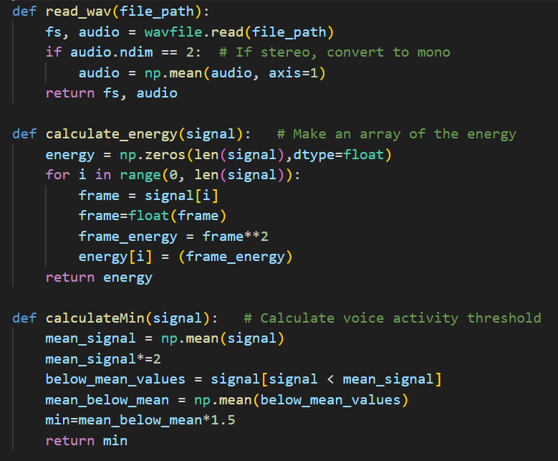
Code Showcase! The first steps – calculation:
We first read the audio signal we take as input from its file path, and we return its sample frequency and its mono version.
We then calculate the energy as we elaborated earlier
And finally, we calculate the voice activity threshold as we explained.

Slide 7
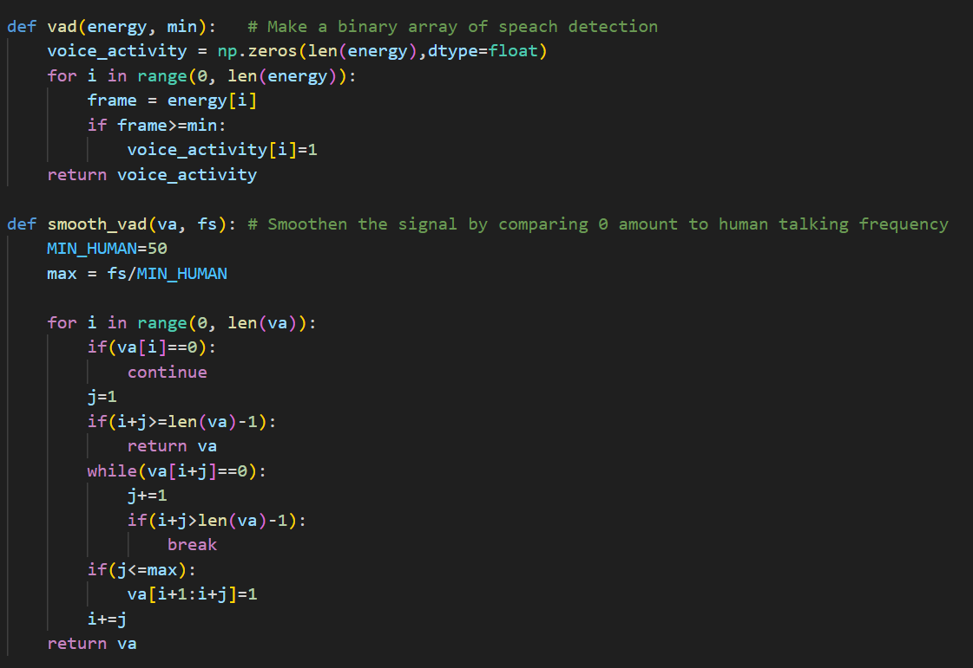
Actual Voice Activity Detection
As we explained earlier – we create a binary array and sort the energy frames to detection of human speech.
We then smooth it out.

Slide 8
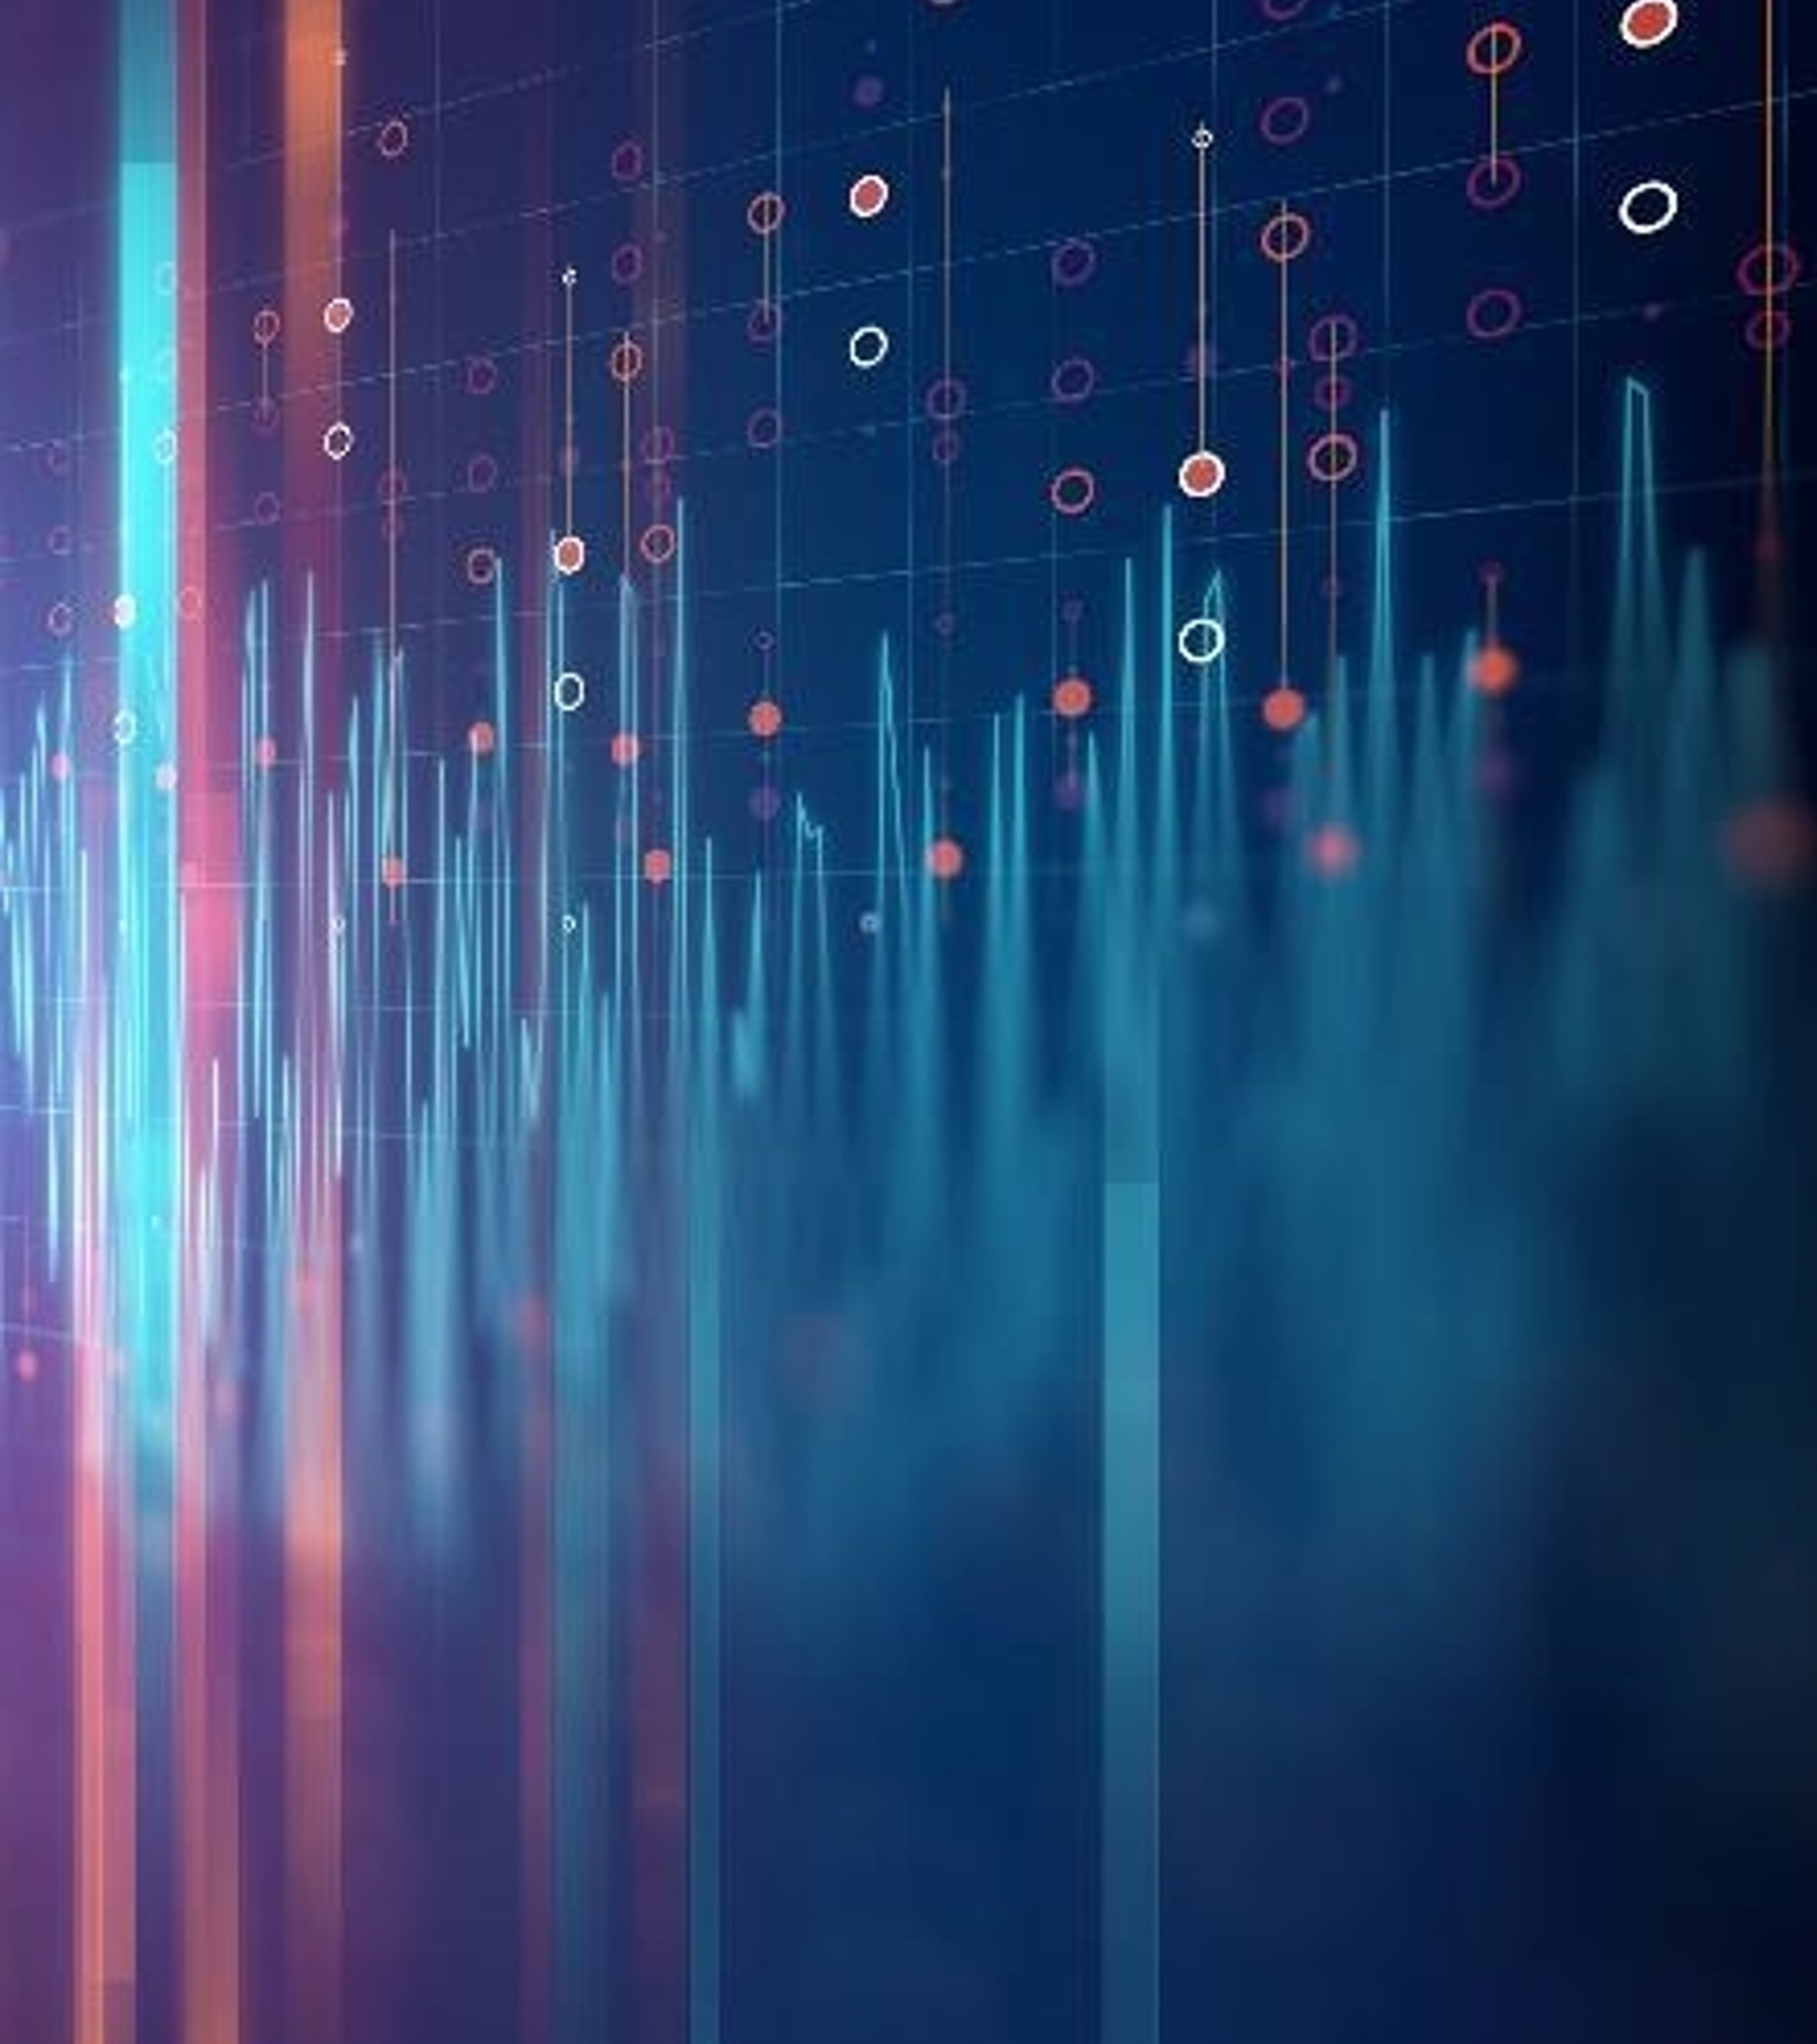
Usage Examples
Nest up we will show 2 examples for .wav files from Moodle

Slide 9
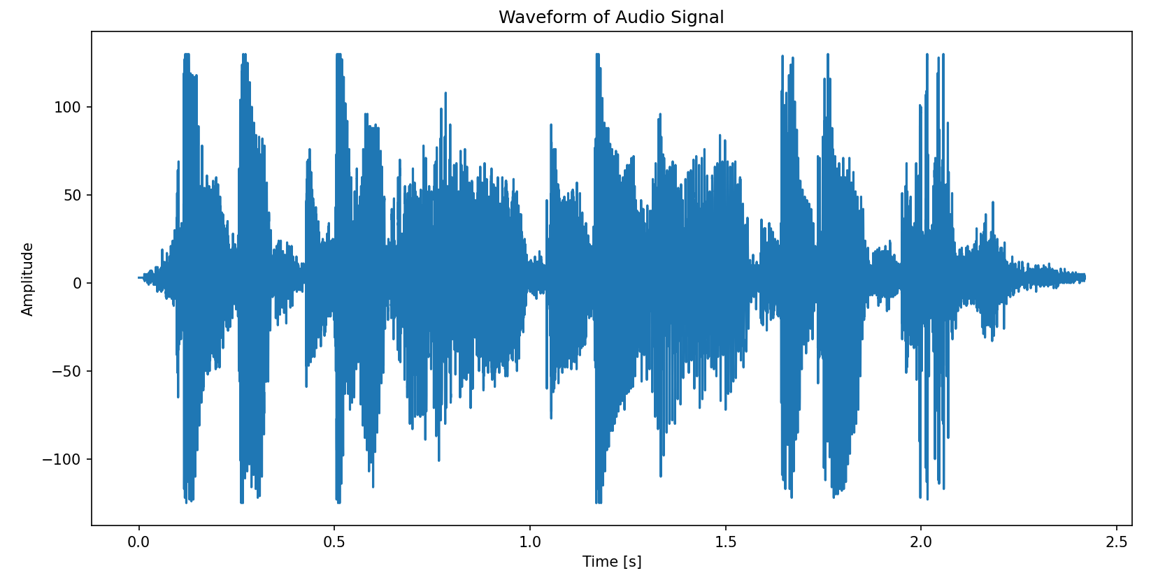
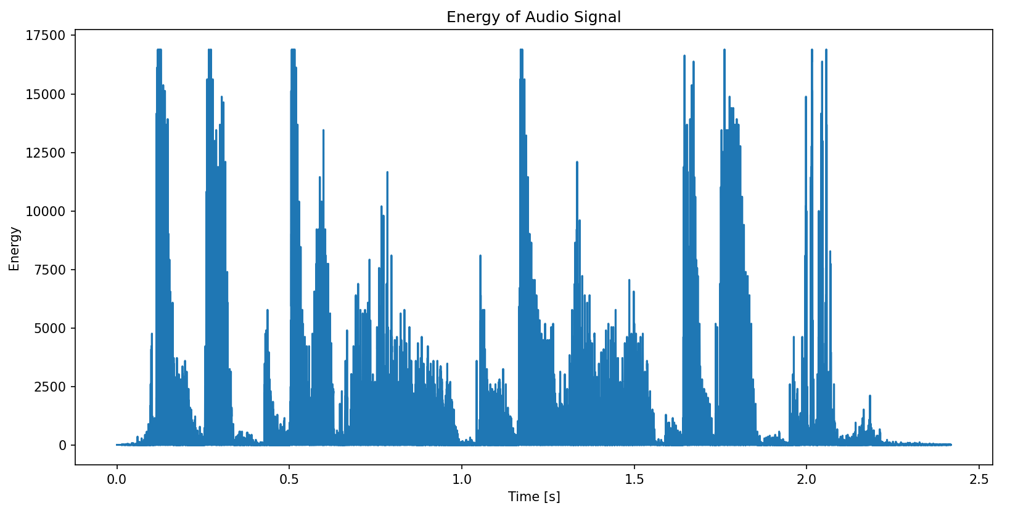
Function in progress

Slide 10
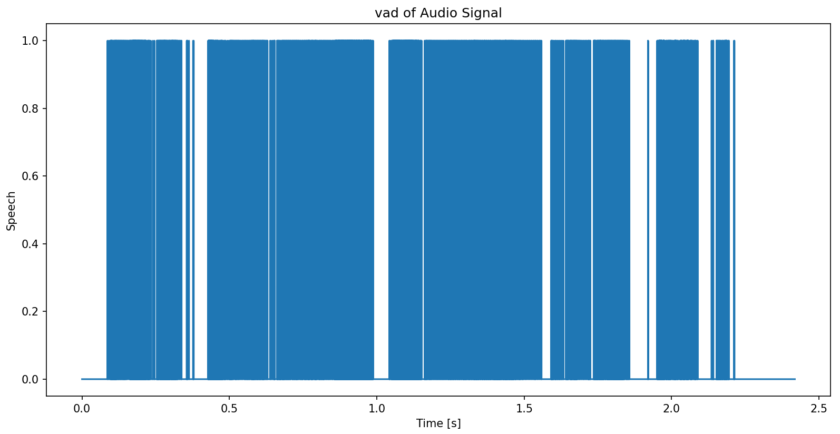
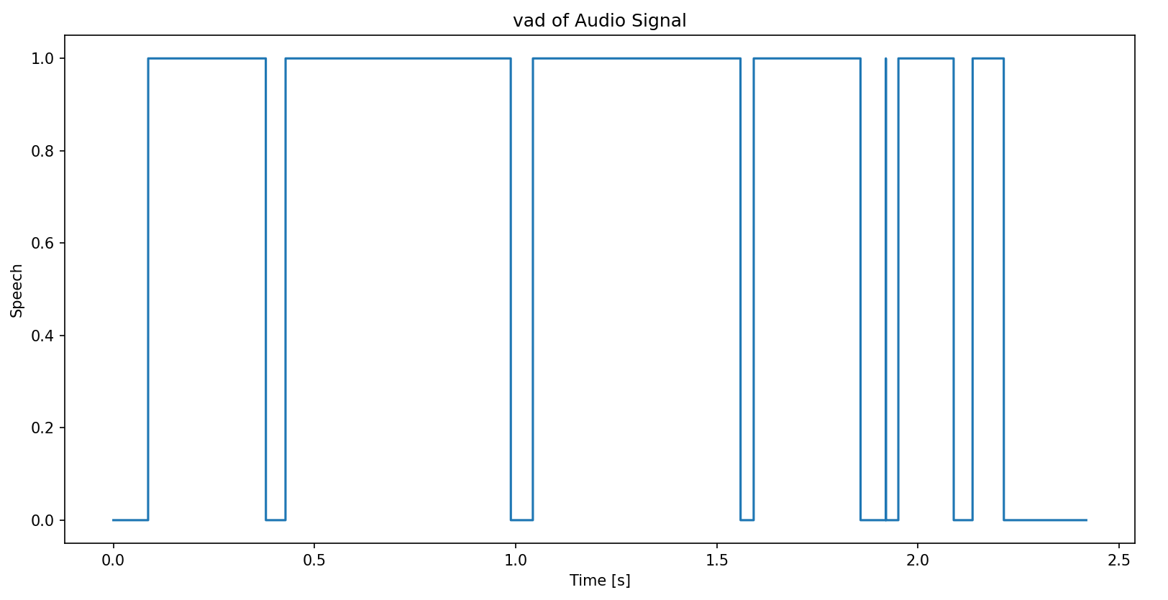
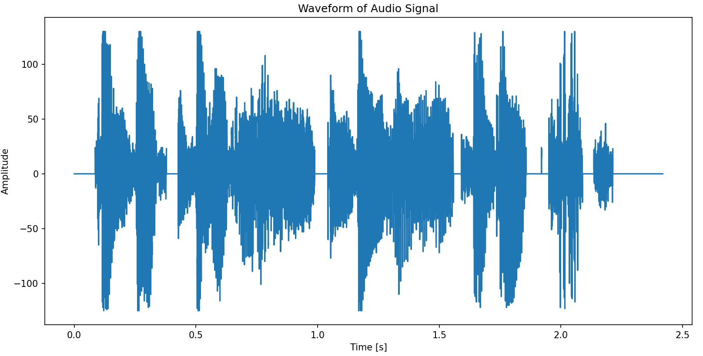

Slide 11

Thank you!
Itai Shimonov – itayatou@gmail.com
Matan Lerner – matan.lrnr@gmail.com

